Slide 1

Click4Good Mumbai/India
Team Members
Akshaykumar Oswal
Anil Wadhwa
Chirag Hingorani
Reshma Bhatia
Rupesh Mishra
Srinivas Ravi

Slide 2
Problem Faced
Deforestation is an important factor in global climate change.
Climate change is because of a build up of carbon dioxide in out atmosphere and if we carry on cutting down the main tool we have to diminish this CO2 build up.
It is estimated that more than 1.5 billion tons of carbon dioxide are released to the atmosphere due to deforestation.
Over 30 million acres of forests and woodlands are lost every year due to deforestation.

Slide 3
Solution
We are working against deforestation.
Giving people a medium where they can contribute to save environment just by a small deed.
User can capture location of a site, which she feels can be used for afforestation.
The server will save its location and provide it to NGO.
NGO will inspect the site and do necessary plantations.

Slide 4
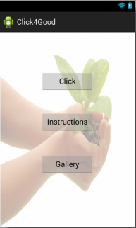

Slide 5
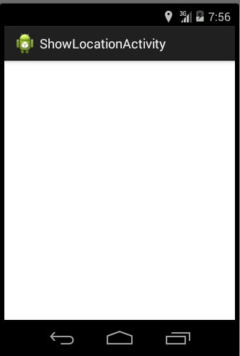
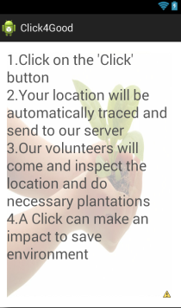
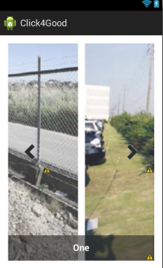

Slide 6
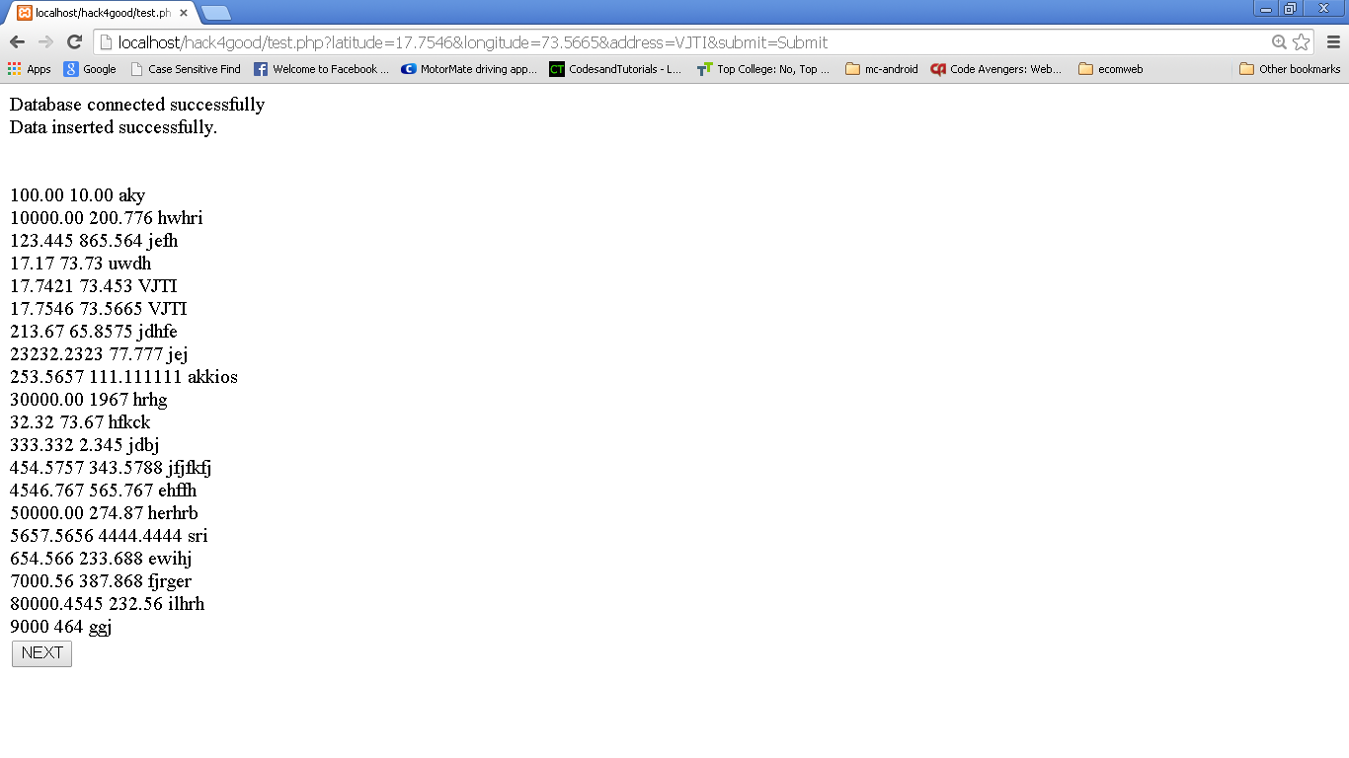

Slide 7
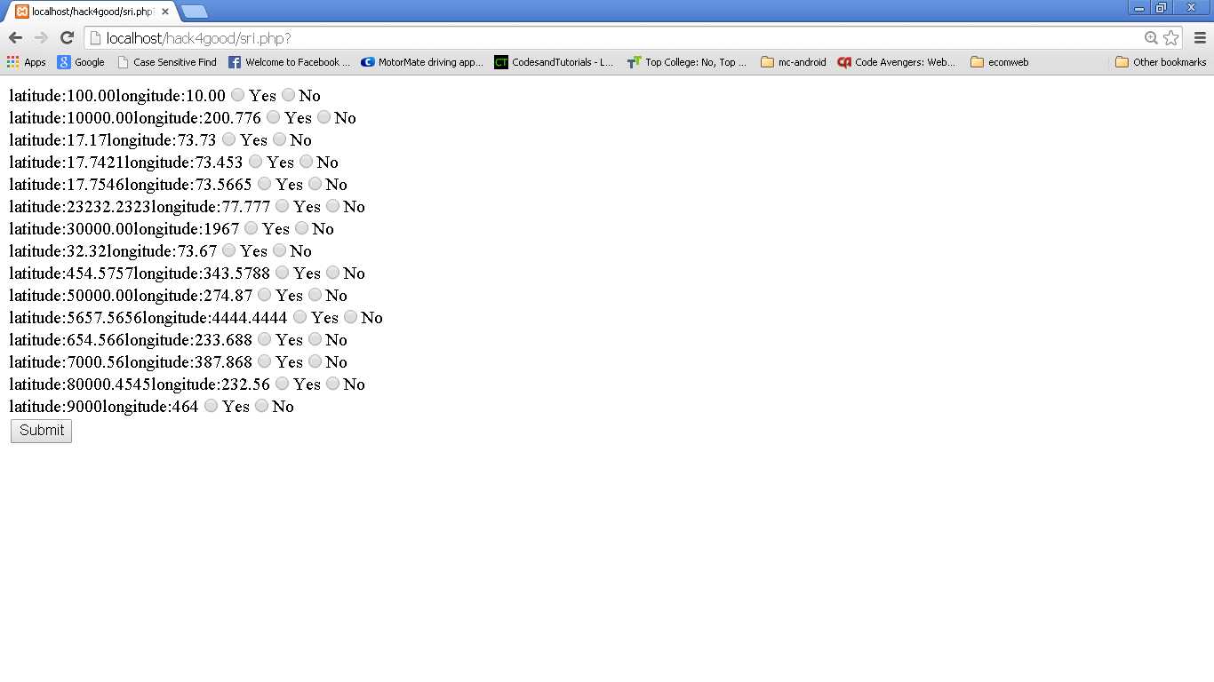

Slide 8
Progress till now…
We made Android app to capture location of the site.
The app attempts to send location details to a remote server.
The server stores and displays all the sites submitted by users. It eliminates redundant submissions for a location thus being efficient.
The NGO has been given interactive form to verify whether a site can indeed be used for plantations.

Slide 9
Future Scope
Providing Notifications to the users gratifying their gesture.
Organizing the online events to protect environment.
Providing people a platform where they can share their ideas for protecting environment.

Slide 10
A CLICK CAN MAKE THE DIFFERENCE !! ☺

Slide 11
THANK YOU !!
KEEP CLICKING !!

